Slide 1

The Discovery of Active Noise Cancellation (ANC)
How Technology Learned to Cancel Unwanted Sound
A JOURNEY FROM PHYSICS TO INNOVATION

Slide 2
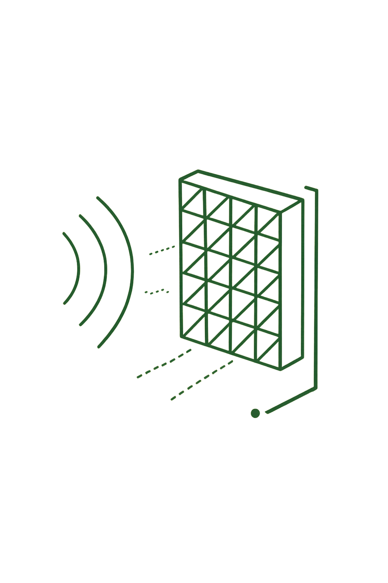

The Problem: Why Passive Isolation Fails
Passive Barriers Fall Short
Foam and earplugs excel at high-frequency attenuation but fail catastrophically against low-frequency energy.
Low-Frequency Penetration
Jet engines, industrial machinery, road rumble — these sounds (20 Hz = 17m wavelength) pass right through foam.
A Different Approach Needed
Not block sound — cancel it. A fundamentally new physics-based solution was required.

Slide 3

Destructive Interference: The Core Principle
The Magic Formula
A sin(ωt) + A sin(ωt + π) = 0
Original Noise
Superposition Principle
Phase Inversion
Acoustic pressures add algebraically — invert and add back for silence.
Anti-Noise
Coherence Requirement
When two acoustic waves of equal amplitude are shifted 180° out of phase, they cancel perfectly — silence emerges from sound.
Anti-noise must precisely match the original noise's frequency and amplitude.

Slide 4
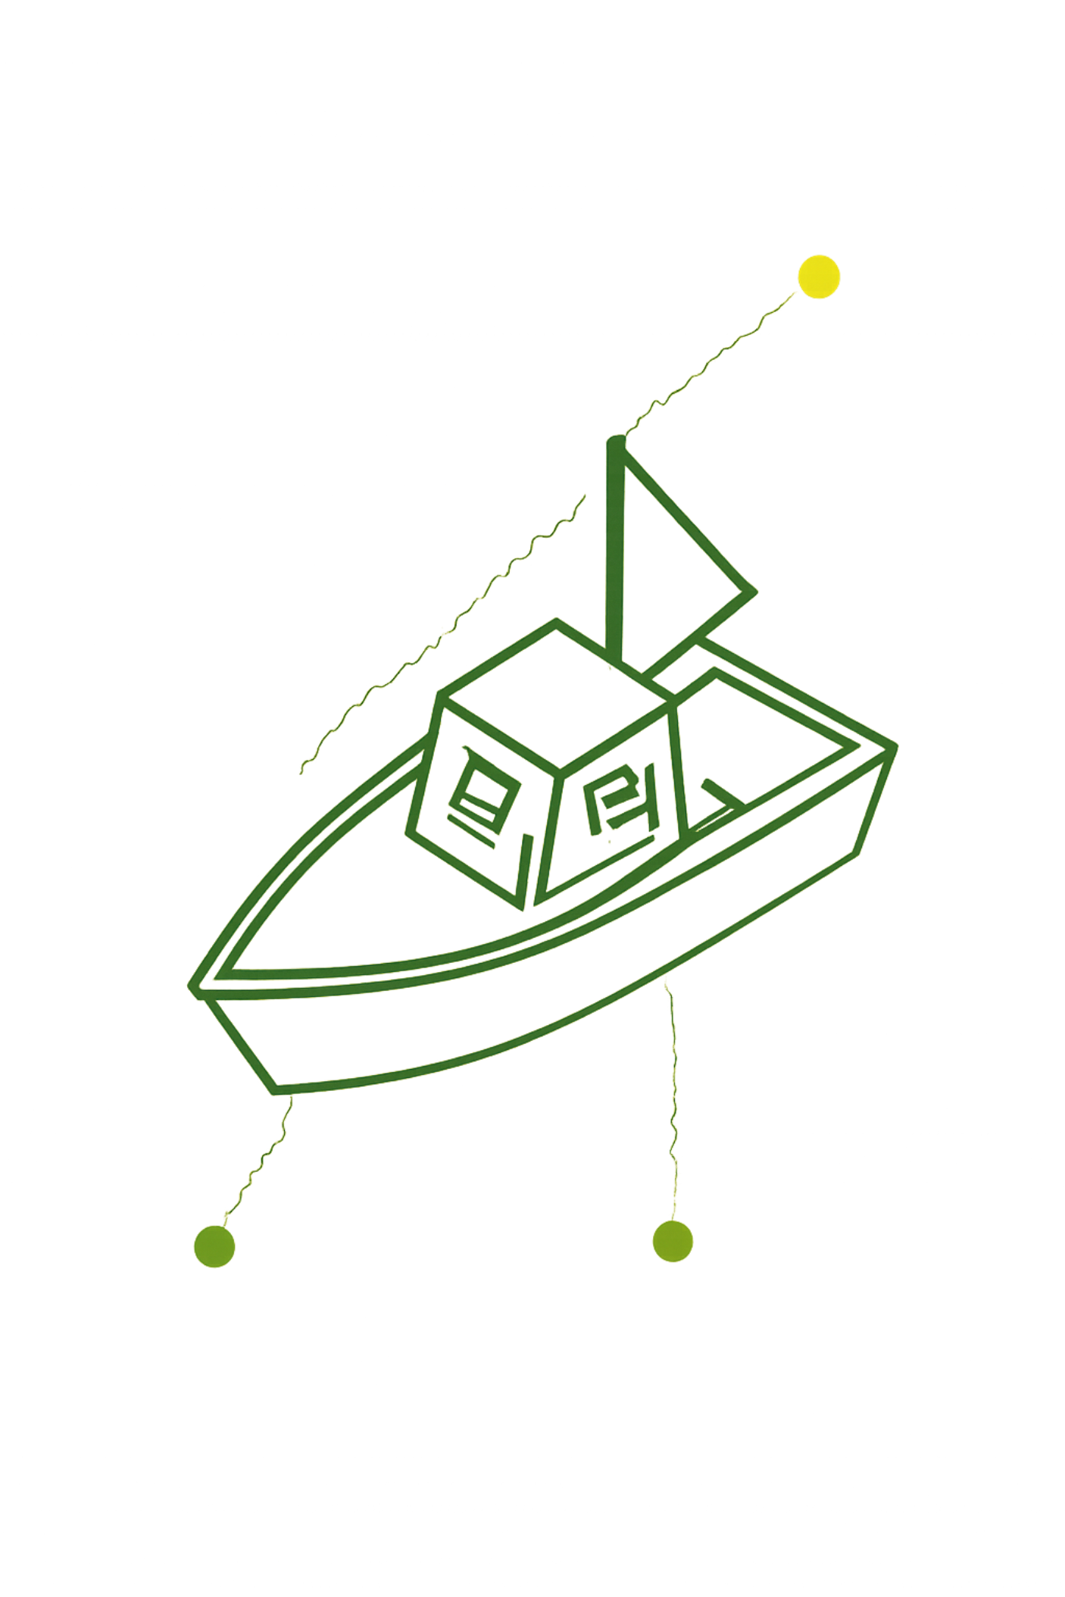
The Pioneer: Paul Lueg (1933)
1
1933
German Patent DRP No. 655,508 — first documented patent for acoustic cancellation in ducts.
2
1936
US Patent 2,043,416 — upstream microphones detect noise, phase inverted, anti-noise broadcast downstream.
3
The Concept
Canceling periodic, stationary noise in confined spaces — ducts, pipes, aircraft fuselages.
4
The Limitation
Purely analog — no real-time adaptation, no feedback control, no adaptability.

Slide 5

Lueg's System Architecture
1
Reference Microphone
Samples incoming noise before it reaches the ear — the critical first capture.
Phase Inverter
2
Inverter Circuit
Reference Mic
Flips the signal exactly 180° and adjusts amplitude for perfect cancellation.
Amplifier
3
Amplifier
Boosts the inverted signal to match the original noise's acoustic power.
Canceling Speaker
4
Canceling Speaker
Broadcasts the anti-noise directly into the acoustic space — silence achieved.

Slide 6
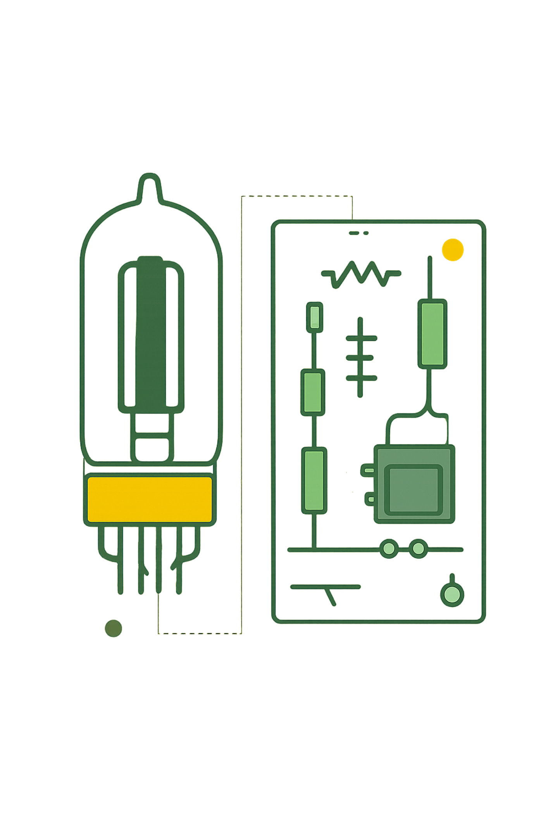




Why Early ANC Stalled (1930s–1950s)
Analog Phase Lag
Vacuum-tube circuits introduced unpredictable delays — phase alignment was nearly impossible.
Acoustic Feedback Loops
Without digital control, systems oscillated — amplifying noise instead of canceling it.
No Adaptive Capability
Manual tuning only — impossible to adjust in real-time as conditions changed.
Power & Size Constraints
Bulky, power-hungry analog electronics — completely impractical for portable use.

Slide 7


The Turning Point: Aviation & Industrial Needs
140+ dB Cockpit Noise
High-performance aircraft generated deafening SPL — threatening pilot communication and hearing safety.
Mission-Critical Communication
Pilots needed to hear radio transmissions clearly while enduring jet engine roar.
Hearing Damage Prevention
Prolonged jet noise exposure caused permanent hearing loss in flight crews worldwide.
Military Funding Accelerates Research
Aerospace investment catalyzed practical, real-time ANC headset development.

Slide 8
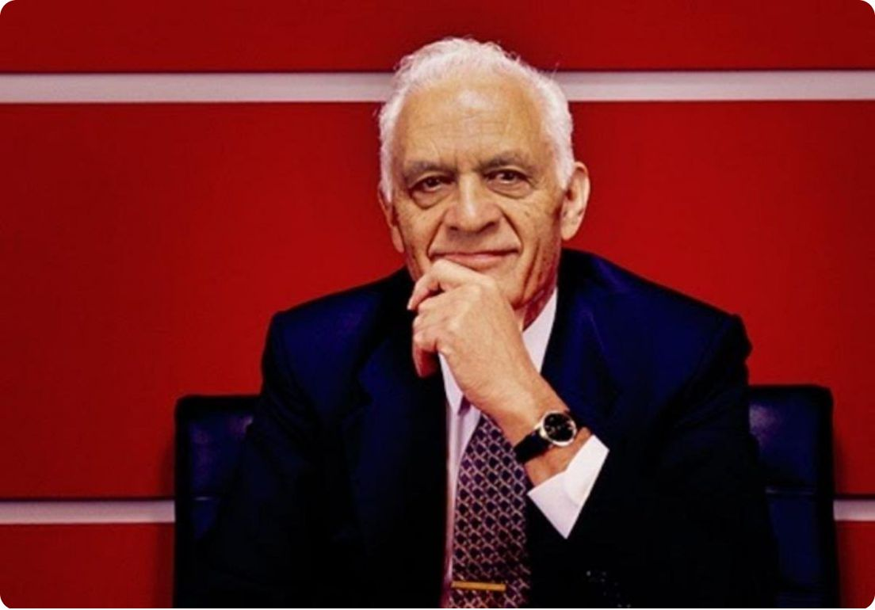

VISIONARY LEADER
Dr. Amar Bose
Founder & Visionary of Bose Corporation
From a frustrating transatlantic flight to revolutionizing how the world experiences sound — one man's insight changed everything.
Engineer. Inventor. Visionary.
Bose Corporation
MIT professor turned world-class audio innovator — Dr. Bose transformed a moment of frustration into a global revolution.
Founded 1964 — built on the principle that great science creates great experiences.

Slide 9
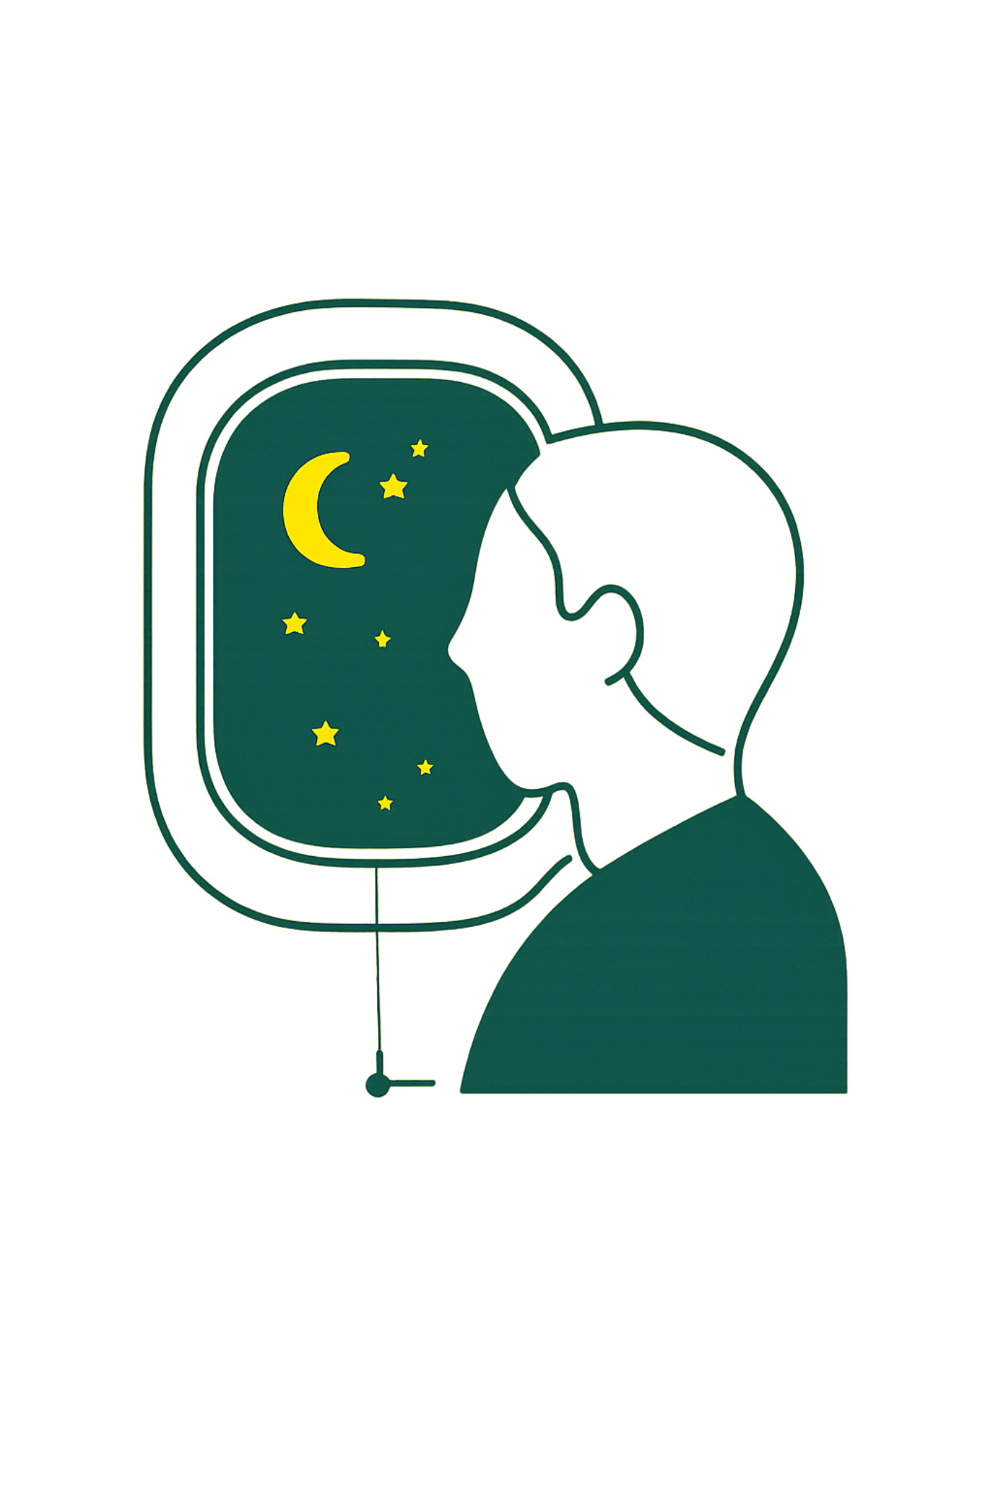
The 1978 Flight Concept
The Frustration
On a transatlantic flight, Dr. Bose's in-flight headphones were drowned out by deafening engine noise.
The Mathematical Insight
Rather than accepting it, he formulated the mathematics of Active Noise Cancellation inside an ear cup — right there on the plane.
The Vision
"What if we could use electronics to cancel noise rather than block it?"
The Commitment
Dr. Bose dedicated Bose Corporation's full resources to transforming theory into practical consumer technology.

Slide 10
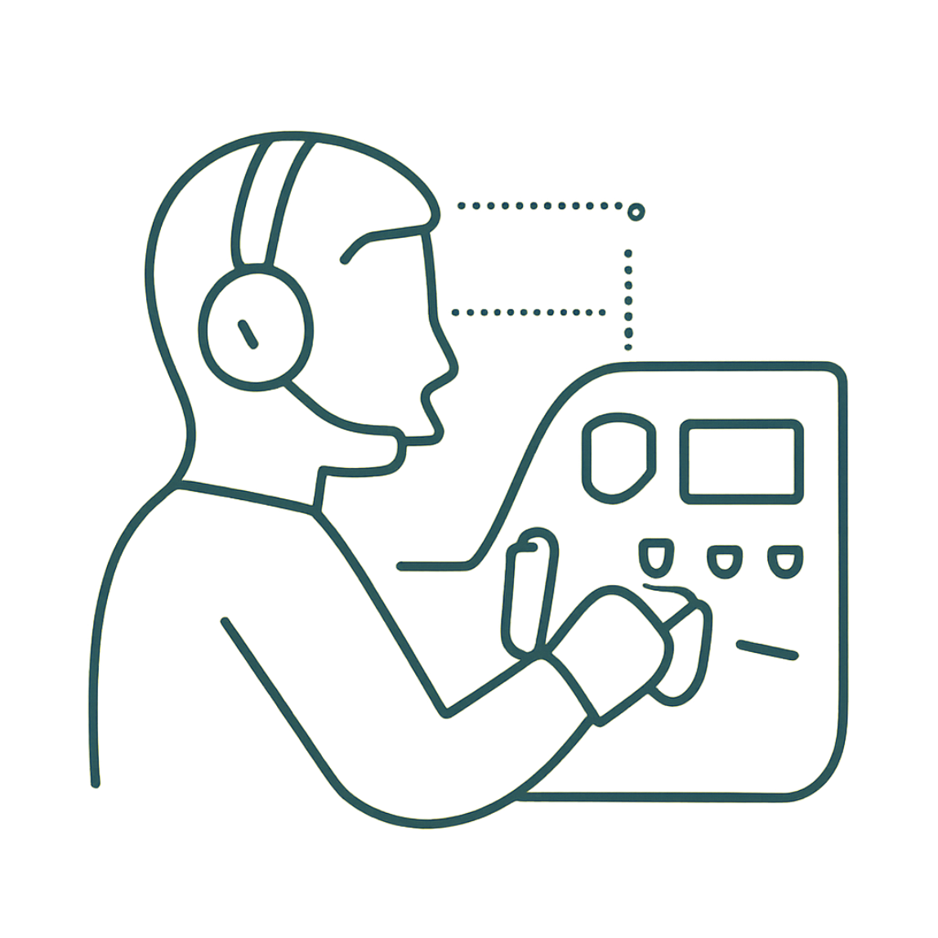

Prototype to Aviation: 1986–1989
1978–1986
1986
Dedicated engineering division established — focused exclusively on ANC development under Dr. Bose's direction.
First mission-critical ANC headset prototypes tested and validated in military and commercial cockpits.
Breakthrough
1989
Feedback microphones inside the ear cup combined with precision analog filters for real-time noise adaptation.
Bose Aviation Headset launches commercially — instantly becomes the gold standard for pilot communication worldwide.
Industry Recognition: Dr. Bose's innovation set the definitive benchmark for ANC performance and reliability in high-stakes aviation environments — trusted by militaries and commercial airlines worldwide.

Slide 11

Commercial Headphone Revolution: 2000 & Beyond
QuietComfort Series (2000)
Dr. Bose brings ANC from specialized aviation into the consumer market — transforming the entire headphone industry overnight.
Market Impact
ANC becomes the defining feature of premium headphones. Competitors scramble. The industry is forever changed.
Accessibility for All
What was exclusive to pilots is now available to commuters, travelers, and everyday listeners everywhere.
Enduring Legacy
QuietComfort becomes synonymous with noise cancellation — a testament to Dr. Bose's vision and engineering excellence that continues to this day.

Slide 12
Thank You
For joining us on this journey through the groundbreaking history of Active Noise Cancellation.
Celebrating Dr. Amar Bose's Vision
His relentless pursuit transformed a simple idea into a technology that enriches lives worldwide.

